Slide 1
Neural Networks

Slide 2
Outline
What is a Neural Network
Activation Functions
Classification
Backpropagation
Gradient Descent
Pipeline
Underfitting vs Overfitting
Conclusion

Slide 3
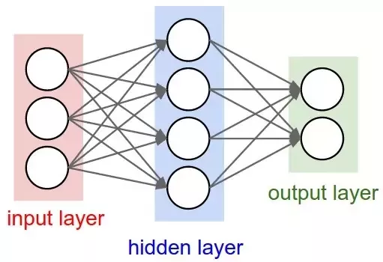
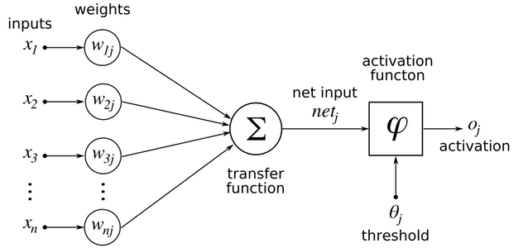
What is a Neural Network

Slide 4
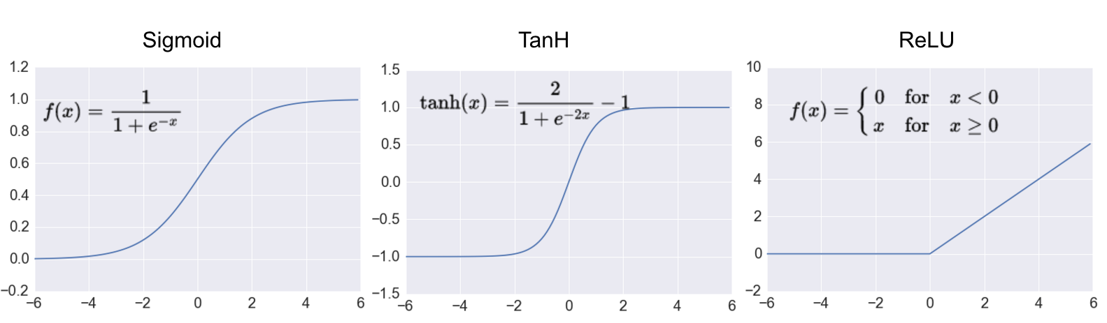
Activation Functions

Slide 5
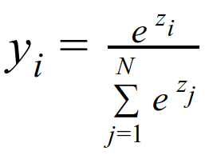
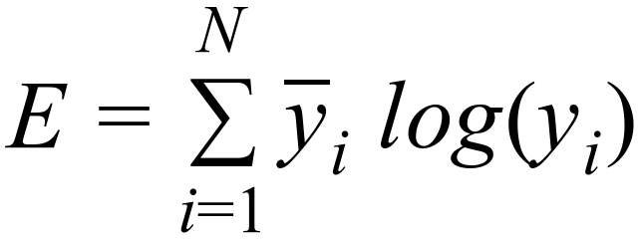
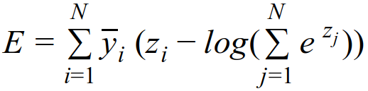
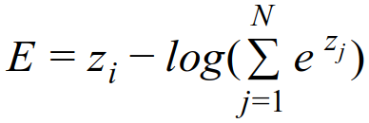
Classification

Slide 6
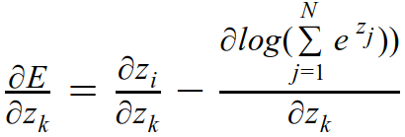
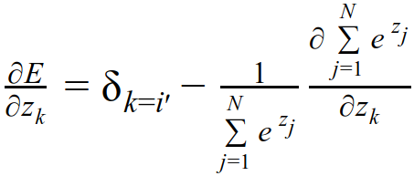
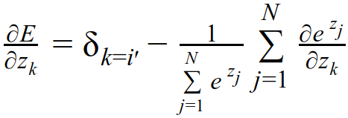
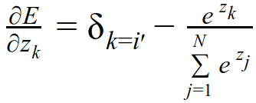

Backpropagation

Slide 7
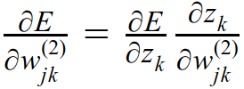
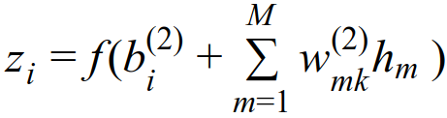
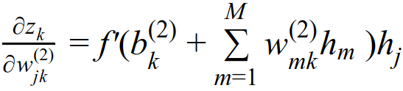

Backpropagation

Slide 8
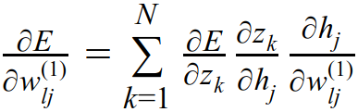
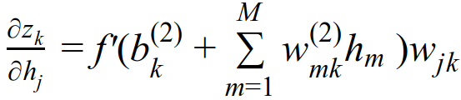
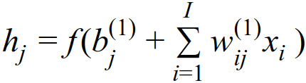
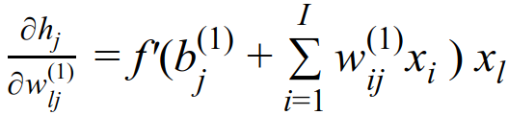
Backpropagation

Slide 9
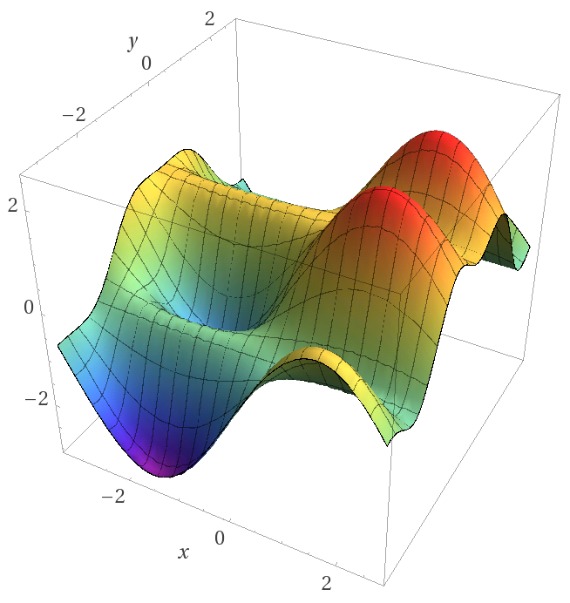
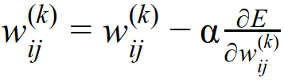
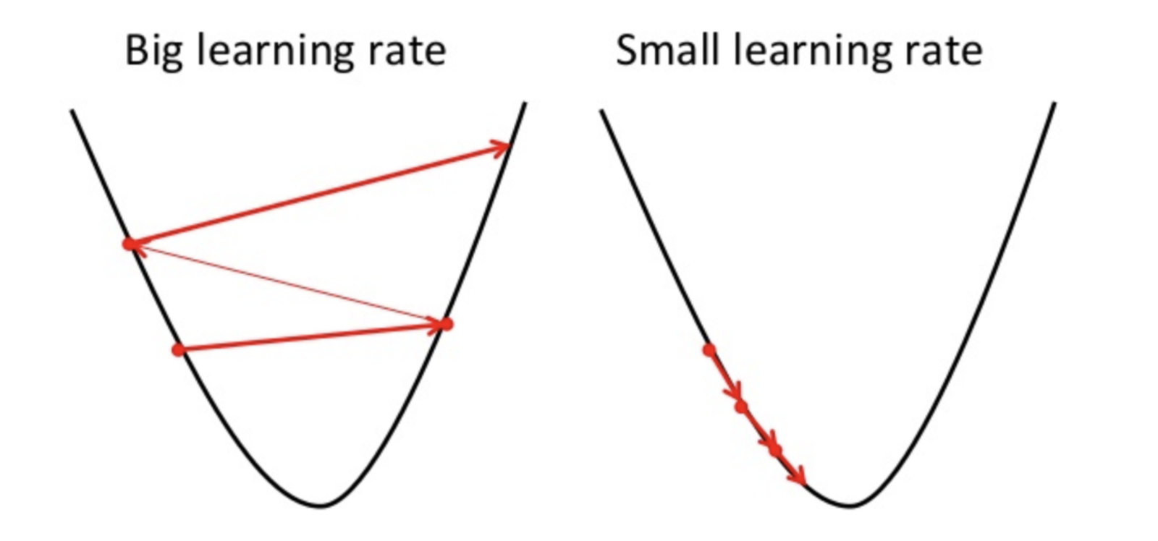
Gradient Descent

Slide 10
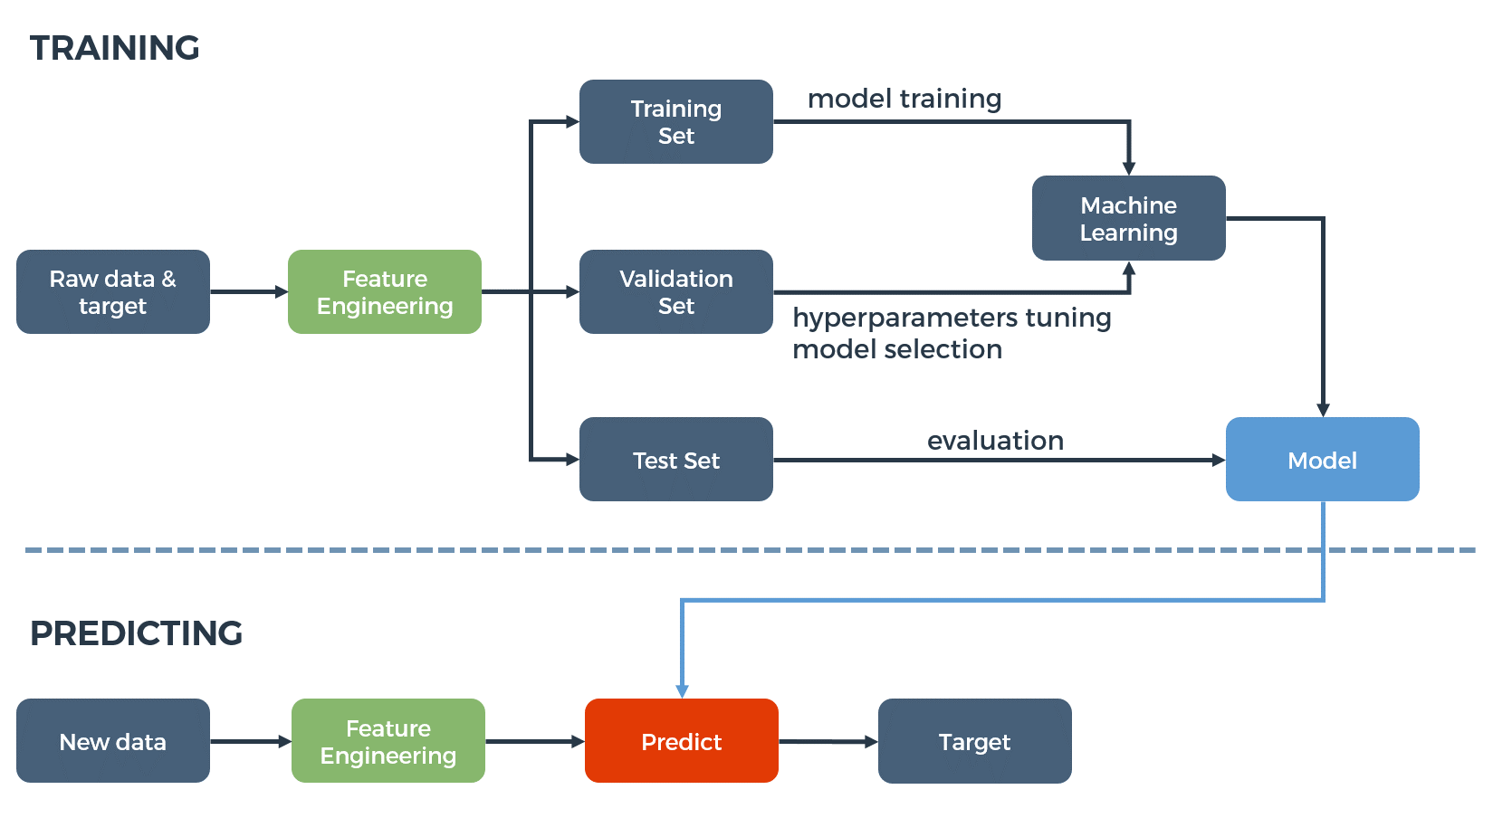
Pipeline

Slide 11
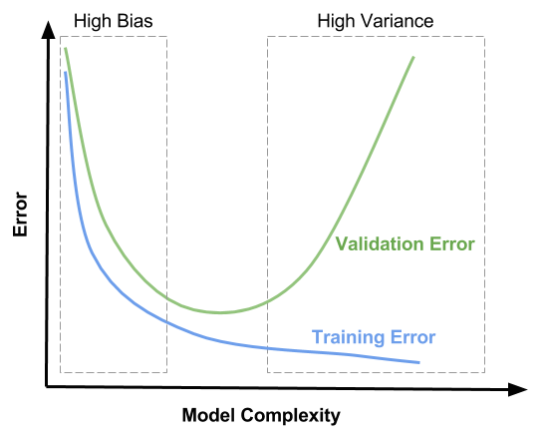
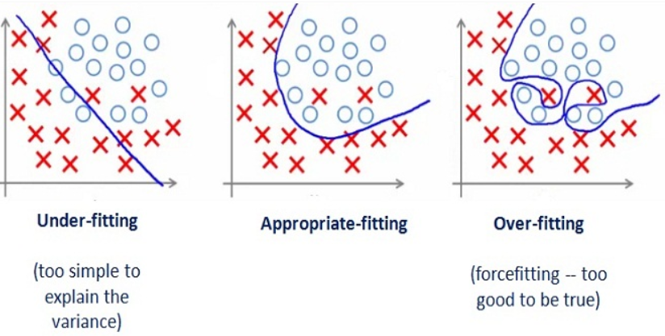
Underfitting vs Overfitting

Slide 12
Conclusion
Neural Networks are effective function approximators
Backpropagation made it possible compute the gradient of every parameter
Optimization using gradient descent (the learning rate is very important!)
Machine learning pipeline in practice
Underfitting vs Overfitting

Slide 13
Questions?

Slide 14
References
https://threads-iiith.quora.com/Neuro-Evolution-with-Flappy-Bird-Genetic-Evolution-on-Neural-Networks
https://www.kdnuggets.com/2016/10/artificial-intelligence-deep-learning-neural-networks-explained.html
https://hackernoon.com/a-brief-overview-of-automatic-machine-learning-solutions-automl-2826c7807a2a
http://adilmoujahid.com/posts/2016/06/introduction-deep-learning-python-caffe/
https://hackernoon.com/training-an-architectural-classifier-ii-bf29eca3cfa6
https://towardsdatascience.com/gradient-descent-in-a-nutshell-eaf8c18212f0
https://www.matroid.com/blog/post/the-hard-thing-about-deep-learning
https://medium.com/greyatom/what-is-underfitting-and-overfitting-in-machine-learning-and-how-to-deal-with-it-6803a989c76
https://www.learnopencv.com/bias-variance-tradeoff-in-machine-learning/

